Slide 1
Cloud Native Enterprise

Slide 2

Cloud Native Enterprise
Continuous Delivery & Microservice Architectures in the Enterprise with Spring and Cloud Foundry
Notes:
Resting slide on screen before you begin presenting.

Slide 3



Nothing lasts for ever​
Bridge Before Hurricane
Bridge After Hurricane
Source https://medium.com/road-less-ventured/why-an-honduran-bridge-is-a-perfect-metaphor-for-disruption-2a2d7c910535

Slide 4
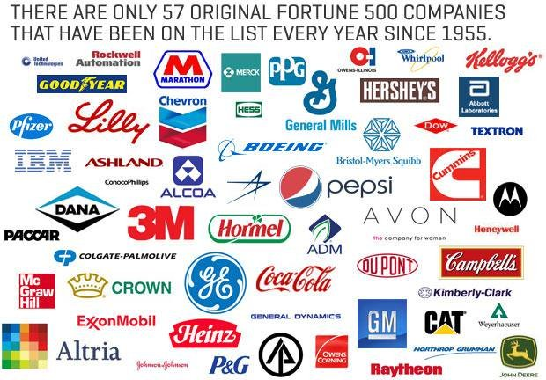
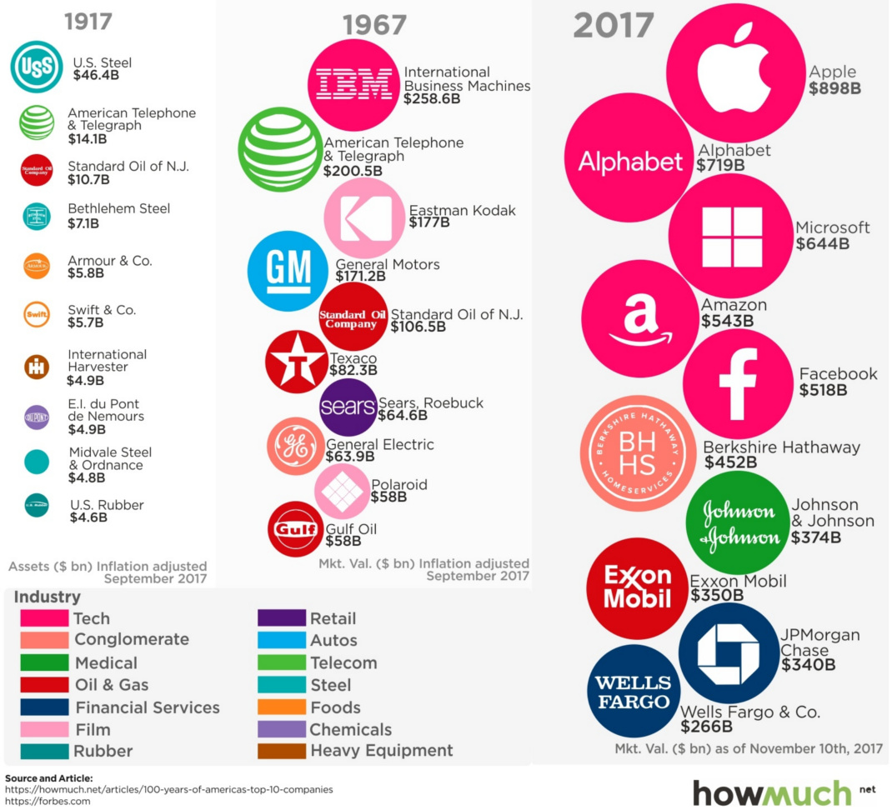
13% of Fortune 500 companies exist since 1955

Slide 5

What percentage of enterprise applications that are in use today will still be in use at least for next 5 years?
75%
85%
90%

Slide 6

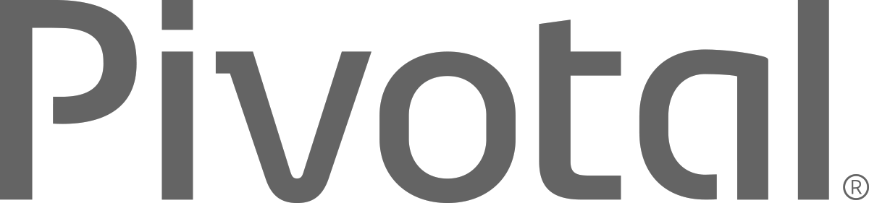
Introduction to
Pivotal Cloud Foundry
Notes:
Platforms
PaaS
Microservices
Cloud Native

Slide 7
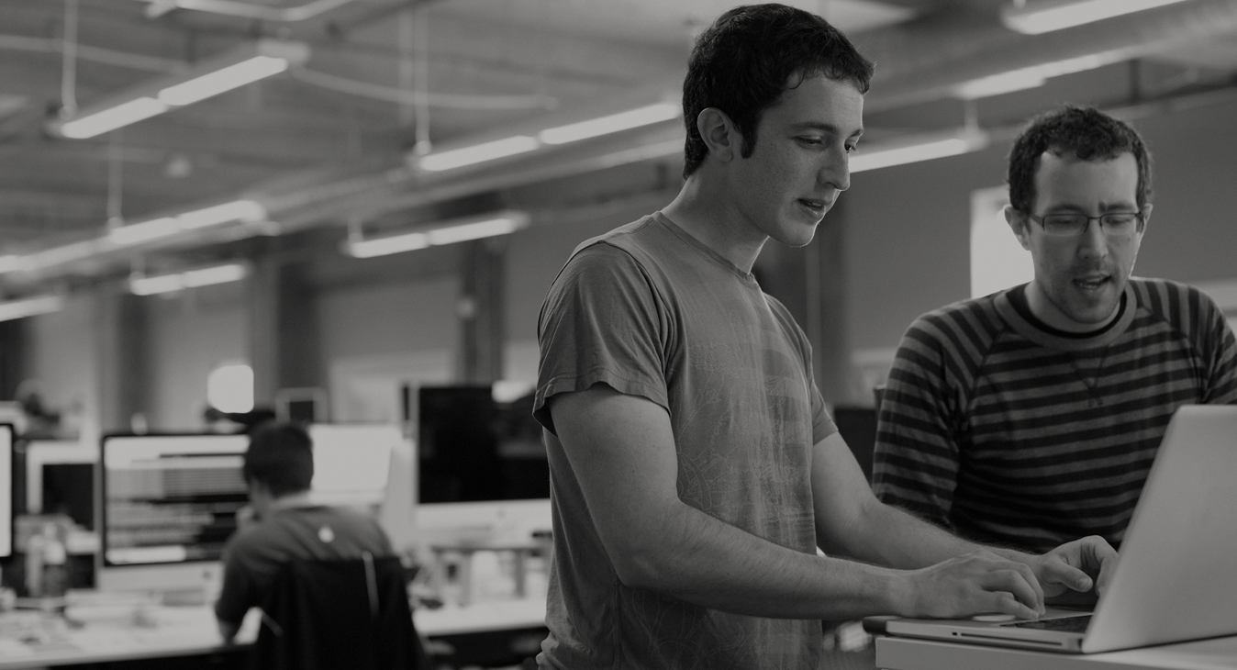

WE BELIEVE
Transforming how the world builds software will shape the future.
Notes:
At Pivotal, we believe Transforming how the world builds software will shape the future.
This is our core guiding principle that shapes our product and corporate strategy. Our success today is your success five years from now. With the ever expanding innovation gap between companies stuck with the status quo, and those companies pivoting with new practices and technology gaining the market, staying competitive means transforming at the core of the business, and in today’s world this core is not just the technology that runs the datacenter anymore, rather its the software development loop that cradles the market innovations, and the operations loop which enables innovation to flow freely. Achieving agility in dev and ops is the keystone to success in a rapidly growing technology space increasingly dominated by lean startups.

Slide 8
DevOps
Continuous Delivery
Microservices
Not my problem
Separate tools, varied incentives, opaque process
Release once every 6 months
More Bugs in production
Tightly coupled components
Slow deployment cycles
Shared responsibility
Common incentives, tools, process and culture
Release early and often
Higher Quality of Code
Loosely coupled components
Automated deployments
Notes:
Ensuring that you are set up to support new (changing) dev patterns with architectural and operations patterns that support "cloud native"; does your deploy velocity match your build velocity?

Slide 9
Software Developers Spend too Much Time NOT Writing Software
Design and Coding
Brainstorming
Administrative tasks
Managing Environments
Waiting for Test/Build
Average Hours/Week
17.5 hrs ~ 40% of full work week!
Sources: “Electric Cloud LinkedIn Survey to software developers”
Notes:
Companies cant be agile with all the process and overhead to get anything done.

Slide 10
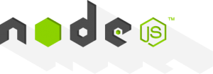
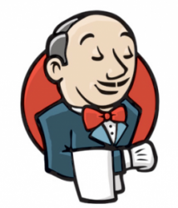
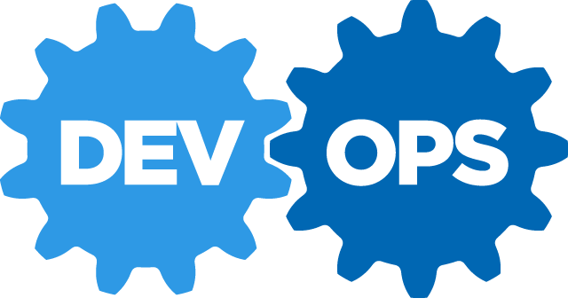

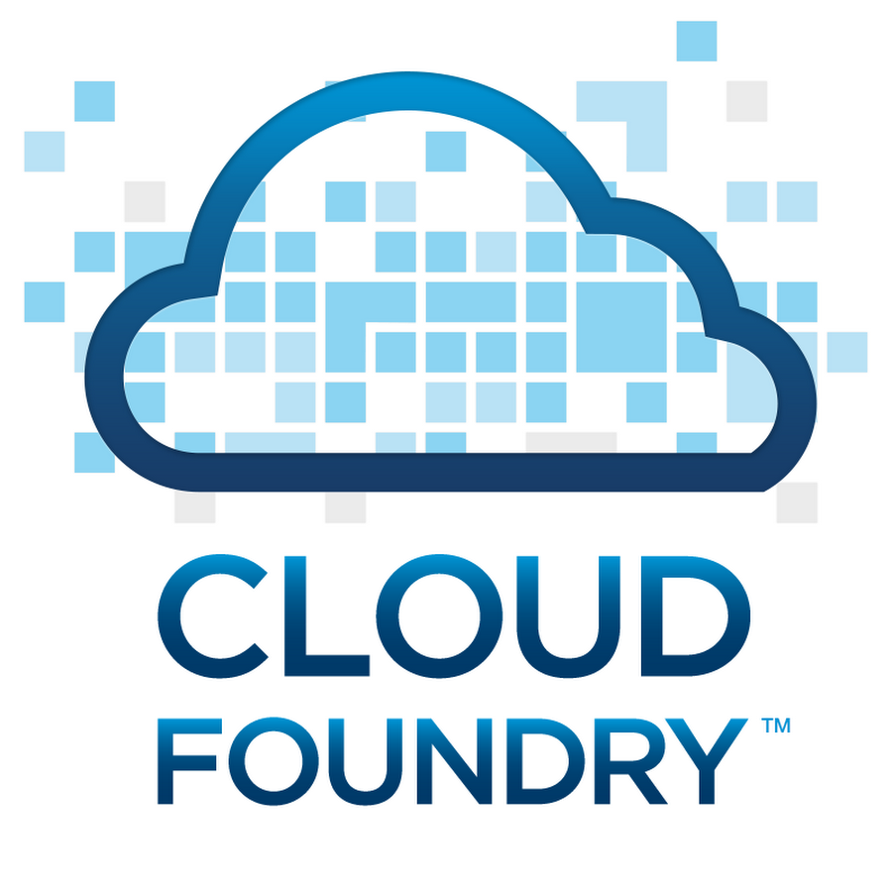
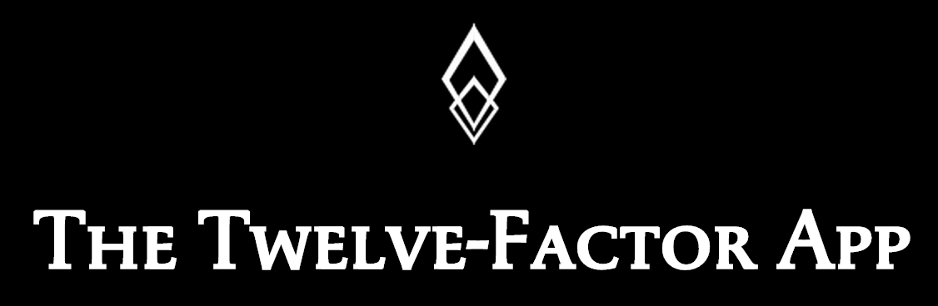


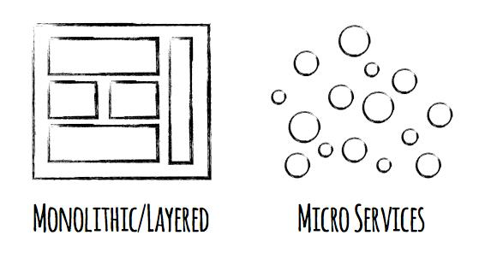


Software is EVOLVING
Continuous Delivery
Spring Boot
Notes:
Software is changing industries but software itself is changing. You hear a lot about buzz-words and new technologies coming to play with ideas such as Microservices, DevOps, Continuous Delivery and of Containerization of workloads made popular by Docker.
Being a modern developer is challenging because it requires constantly updating ones knowledge and skills, but its also so exciting, because never before have we been able to get into the flow with less technical roadblocks.
By the end of today, youll be fluent in all these technologies.

Slide 11
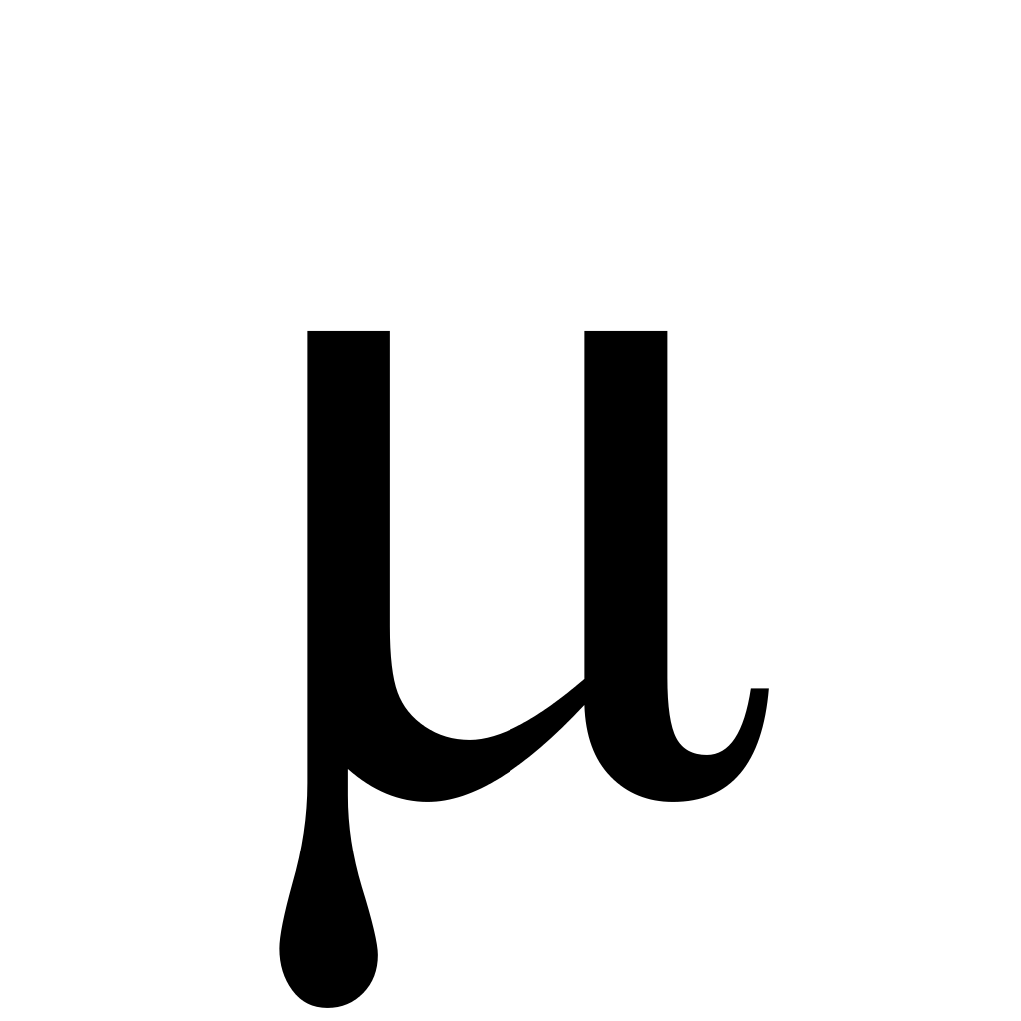
Evolving to a Microservice Strategy with Cloud Native Architecture (Ecosystem)
DATABASES AND DATA MANAGEMENT
Traditional RDBMS
Oracle MySQL
SQL Server
NoSQL datastores
MongoDB Cassandra
Couchbase
Cache and IMDG
Gemfire Coherence
VERSION CONTROL
Github
Gitlab
SVN
CI / CD
Jenkins
Concourse
Artifactory
SECURITY & COMPLIANCE
OAuth
UAA
LDAP
Kerberos
SSL/TLS
PCI
HIPAA/HL7
METRICS & DASHBOARDS
Collection
Storage
Dashboards
Alerts
Spinaker
DEVELOPMENT FRAMEWORKS
Spring / SCS
Entity Framework
Micro
API MANAGEMENT
APIGee
Mashery
DIY
What does it take to deploy and operate ALL this at SCALE
DATA MICROSERVICES
Spring Cloud DataFlow
Storm
Flink/NiFi
LANGUAGES
Java
.NET
Python
DISCOVERY & REGISTRATION
Consul
Eureka
etcd
CIRCUIT BREAKERS
Hystrix
DIY
LOAD BALANCING
Ribbon
Zuul (client side)
Ruby
Go
*.JS
Zookeeper
Where should your best developers focus to maximise BUSINESS VALUE?
MONITORING & LOGGING
Log Aggregation
Storage
Thresholds
Metering
CONTAINERS
MESSAGING
Garden Docker runC
Kafka RabbitMQ
CONTAINER
ORCHESTRATION
Cloud Foundry Runtime Kubernetes Swarm Marathon ECS
NETWORKING
DNS
Load Balancing
Intelligent Routing
Network Segmentation
Firewalls
CLOUD ORCHESTRATION
& AUTOMATION
BOSH / Cloud Foundry Chef Puppet Ansible SaltStack Mesos
PRIVATE CLOUD
PUBLIC CLOUD
vSphere OpenStack
AWS Azure GCP

Slide 12

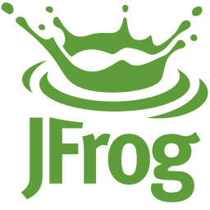
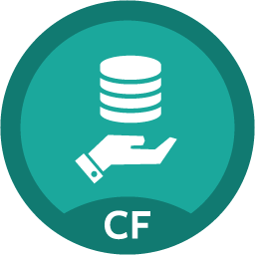
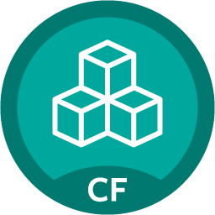

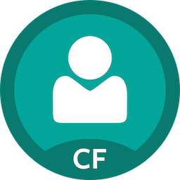
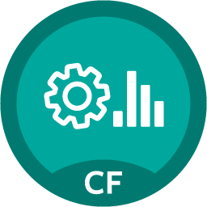
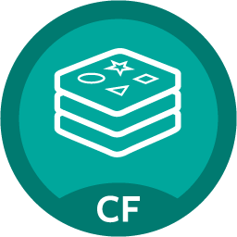
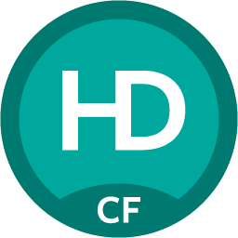
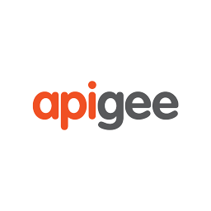

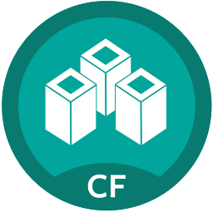
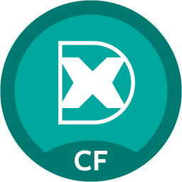
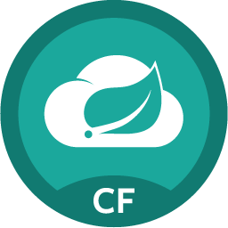

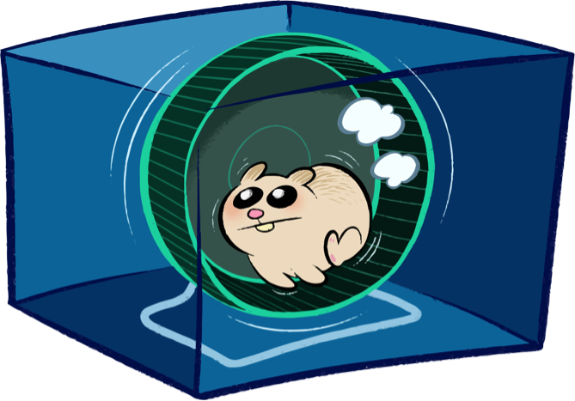
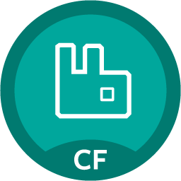
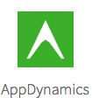
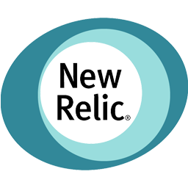

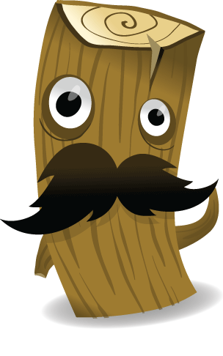

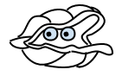
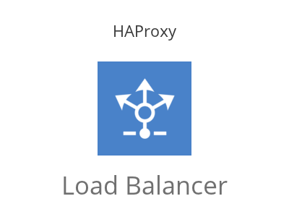
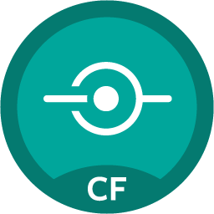




Enabling Microservice Strategy with Cloud Native Architecture (PCF)
DATABASES AND DATA MANAGEMENT
VERSION CONTROL
CI / CD
SECURITY & COMPLIANCE
SSO
IPSEC
METRICS & DASHBOARDS
PCF Metrics
PCF Logging
Gitlab
Ops Manager UI
Jenkins Artifactory
BOSH Director
CF CLI + API
MySQL Gemfire
DEV FRAMEWORKS
Buildpacks
API MANAGEMENT
Ops Manager (Admin)
Redis Pivotal HD
Apps Manager UI
Service Marketplace
CF CLI + API
DATA MICROSERVICES
LANGUAGES
Java
Python
PHP
.NET
DISCOVERY & REGISTRATION
Consul
Eureka
etcd
CIRCUIT BREAKERS
Hystrix
DIY
LOAD BALANCING
Ribbon
Zuul
Apps Manager (Dev)
Ruby
Node
Go
Spring Cloud
Dataflow
Service Broker
MONITORING / LOGGING
CONTAINERS
MESSAGING
PCF Managed
Docker RunC
RabbitMQ
PCF Provided
CONTAINER
ORCHESTRATION
PCF Elastic Runtime
Service Broker
NETWORKING
CLOUD ORCHESTRATION
& AUTOMATION
BOSH
Corp Managed
(or external)
PRIVATE CLOUD
PUBLIC CLOUD
User Provided
Azure
HA Proxy Router

Slide 13
Cloud Ready Poll
App upgrades require planned outage?
Apps are hard to scale up or scale down?
App downtime when pulling cables at random in the datacenter?
13
Notes:
If you answer yes to any of these questions, you need a platform
People with Cloud Foundry on the right infrastructure say No to each question

Slide 14
It Takes a Platform
An end-to-end structured platform makes resilient distributed App
best practices, a turn-key,
first practice
14
Notes:
Mention the opinionated platform.
Structured vs Unstructured.
The word platform is thrown around alot these days. You’ve probably heard the word PaaS a few times already – its become the word of the year already. However, lets make a distinction, structured platforms vs unstructured platforms.

Slide 15
Cloud Native Application Platforms
Business Value, Agility & Cost Savings
Traditional IT
IaaS
Cloud Native
You Manage
Applications
You Manage
Applications
Applications
Data
Data
Data
You Manage
Runtime
Runtime
Runtime
Middleware
Middleware
Middleware
Pivotal CF
+
Choice of IaaS
O/S
O/S
O/S
Virtualization
Virtualization
Virtualization
Servers
Servers
IaaS
Servers
Storage
Storage
Storage
Networking
Networking
Networking

Slide 16



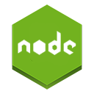




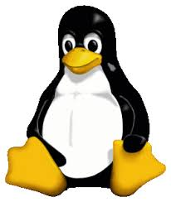



Helping You Modernize Efficiently at Scale
DEVELOPMENT
OPERATIONS
AUTOMATION
To Lower Your Ops Cost and Increase Your Velocity
App Deployment
& Management
CI/CD Tools,
ID, Security
4. CLOUD
NATIVE
FREEDOM
To Run Your App on Any Cloud
Compiled, staged, containerized, deployed and managed by platform, or BYO Cloud Ready Docker Image
Health, Metrics,
Patching
Availability
3. CLOUD
RESILIENT
VISIBILITY
End to End Logging, Monitoring and Auditability
Services
Marketplace
Native
User Provided
Partner
Visibility &
Administration
Apps & Platform
Dashboards
GOVERNANCE
Common Set of Developer-Self-Serviced Frameworks
2. CLOUD
FRIENDLY
RESILIENCY
Auto-Scale, Blue/green Deployments and Health Mgmt.
Operating
System
Container Orchestration
1. CLOUD
READY
SPEED
Move Cycle Time from Months to Weeks to Days or Hours
Cloud API
Azure
GCP
16

Slide 17
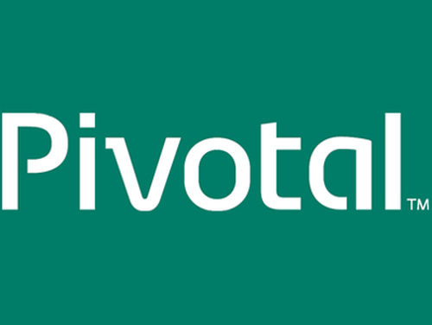

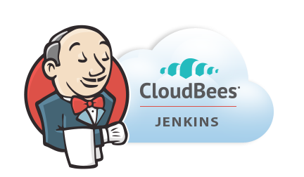

Application Lifecycle Management: CI/CD
AUTOMATION.
Integrate tools and automate processes from testing to builds and deployment.
SPEED.
Releasing more frequently with fewer bits will reduce complexity and improve time-to-market.
QUALITY.
Shorten feedback loop using test-driven development to surface problems sooner.
AGILITY.
Push updates on regular basis with no downtime to improve customer experience and time to market.
Commit Code Change
Automate Build & Test
Manage Binaries & Build Artifacts
Pivotal Cloud Foundry (Elastic Runtime)
Build Pipeline Operations
Gitlab
Jenkins
Develop, Test, QA and Production on the same platform.
Horizontal scaling, high availability, security, logging, update management
Built-in ecosystem of services.
Deploy, operate and scale on IAAS of choice.
Simple, developer friendly commands and APIs.
Tool Chain
Build, test and deploy software projects continuously and incrementally. Thousands of compatible plugins.
Distributed revision control and source code management. Collaborative software development.
Share binaries and manage distributions. Manage artifact lifecycle.
Notes:
Highlight here that if we had a Docker step for building images, we would add ~15 minutes to the process.

Slide 18
Four Levels High Availability – Built In!
PCF
PCF
PCF
Zone 1
Zone 2
A
B
C
A
B
C
A
B
C
A
B
C
A
B
C
A
B
C
A
B
C
VM1
VM2
VM3
B
B
B
B
Runtime VM
3. Resurrector restarts failed VMs
Process
B
A
B
C
A
B
C
A
B
C
A
B
C
OS,
Mware
OS,
Mware
OS,
Mware
B
B
B
B
If an app fails, PCF reboots app in a new container.
If a process fails, PCF restarts the process
If an OS or network failure occurs PCF kills the VM and reboots the host in a new Virtual machine.
If a datacenter rack fails, PCF ensures applications stay running in multiple availability zones
App Fail
Process Fail
VM Fail
Rack Fail
Notes:
Application performance and reliability have a direct correlation to HA capability. Pivotal provides 4 level of HA so that you don’t need to invest in people/software to handle common failure situations. If an application fails, we will reboot it in a new container. This automated remediation addresses application bugs that result in outages. If a Pivotal process fails, we will reboot it in a new virtual machine. Our PaaS essentially monitors and remediates itself. If an OS or network failure occurs, our VM monitor will detect this and kill the VM, then reboot it in a new container. This streamlines Linux sysadmin operations. Lastly, if a datacenter rack fails, we will ensure the application stays running because we load application instances in multiple availability zones. No 2 availability zones live on the same datacenter rack. This hardware failure level resilience is very difficult to design using traditional tools provided by HP/CA/IBM.
And, by using Pivotal, you reduce the number of servers that require HP/CA/IBM monitoring tools.

Slide 19

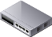

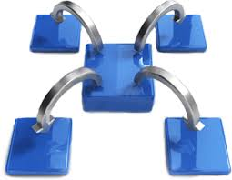
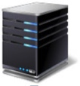

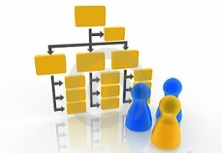





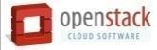

Pivotal CF: Technical Capabilities
Automatic App Server & OS Configuration with Buildpacks (“just push your app”)
Application
Containerization & Cluster Scheduling
Application Network Security Groups
App Health Management, Load Balancing,
Rapid Scaling, Availability Zones
Application to Services Binding and Access
Policy, Identity and Roles Management
Logging as a service,
Application metrics & performance,
Metric based scaling
Native & Extended Data, Mobile and Platform Services
IaaS Provisioning, Scaling & Configuration
Deploy, Operate, Update & Scale with minimal downtime on choice of IaaS
Notes:
Key Platform Capabilities
On Demand Scaling
Application Health Management
Dynamic Routing & Load Balancing
Log and Metric Aggregation
Security
WHAT
Pivotal CF is next generation middleware that delivers 9 things that are typically delivered via point software products.
We provision operating systems and middleware.
We deliver workload density without compromising application performance.
We ensure that applications have appropriate network security safe guards to prevent security threats.
We support application connections to external sources including databases and legacy middleware.
We provide 4 levels of HA, with built in load balancing for scale in/out
We support multi-tenant environments so that each line of business can operate with a discrete quota and isolated system access.
We provision next generation data services including NOSQL databases, traditional databases and hadoop clusters.
We provide horizontal and vertical scaling for the underlying IaaS so that you can scale your infrastructure in lock step with your Business.
We provide a built-in log aggregation service, built-in APM metrics and utilization based auto-scaling so that you can monitor the health of your applications and scale out without human or 3rd party tool intervention.
I am going to cover each of these 9 capabilities in more detail, but it’s important to note the impact of this collection of capabilities. The following slides will include information on CAPEX and OPEX reduction. We will also discuss how you can deliver faster time to value while holding the line on infrastructure cost.

Slide 20

How many members in this group are actively migrating/ modernizing legacy applications?

Slide 21
How many people are building microservices net new?​

Slide 26
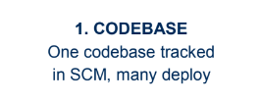
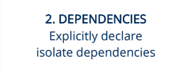
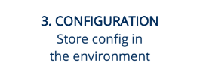
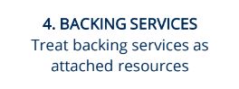
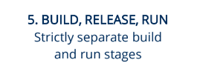
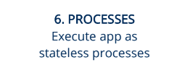
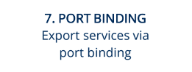
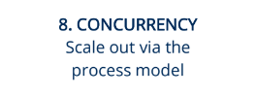
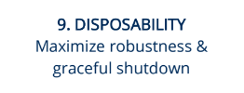
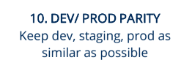
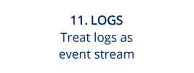

Compliance to 12/15 Factor
12
FACTOR

Slide 27
Characteristics of Cloud Native Architectures
Twelve Factor Apps (http://12factor.net/)
Continuously Delivered
Microservices
DevOps
Self-Service agile infrastructure
API-based collaboration
Anti-fragility

Slide 33
What are Microservices?
If every service has to be updated in concert, it’s not loosely coupled!
Loosely coupled service oriented architecture with bounded contexts
If you have to know about surrounding services you don’t have a bounded context.
Notes:
I presume you’re all familiar with microservices and cloud-native, but quickly, here’s an introduction. They’re loosely coupled, service oriented architecture with bounded contexts.
Because each service can be updated independently, your teams can work in parallel. Because each service is isolated, it’s much easier to automate your testing.

Slide 34
Microservices are NOT
Monolithic Application
Service
Service
HTML
JavaScript
MVC
Enterprise Service Bus
Service
Service
OR
Data Access
Service
Service
Tightly Coupled
Centralized

Slide 35







Microservice Architecture
Business Change
HTTP
HTTP
HTTP
HTTP
HTTP
HTTP
AMQP
AMQP
…
Relational
DB
Key/Value
Store
Graph
DB
Notes:
REST and message-driven services
Polyglot persistence, services encapsulate data store semantics
Diversity of clients acknowledged
API Gateway for service aggregation, reduce chattiness, protocol translation, reduce latency/round-trips, deal with mobile device fragmentation, build use case/device specific API’s

Slide 36



Strangler Pattern
Source: https://www.martinfowler.com/bliki/StranglerApplication.html

Slide 37

Domain Driven Design
An approach for designing software system that model the complexity of the real world
Kicked off in 2004 by Eric Evans
A practical microservice design methodology

Slide 38

Strategic Domain Driven Design
Domain
Sub-Domain
Bounded Context
Ubiquitous Language
Context Map
Notes:
Picture from http://www.quikmaneuvers.com/principles_of_strategy.html need to check on license rights
Bounded Context - A Bounded Context is the boundary that surrounds a part of a particular domain. This boundary isolates the model and language from other models and therefore helps reducing ambiguity and clarifying the meaning. When the boundaries are chosen well, greater decoupling between systems can be achieved which allows to easily change or replace the internals of a BC. Avoid having transactions across multiple BCs.
Ubiquitous Language - The language that is structured around the domain model is called the Ubiquitous Language. It is important that this language is used by all team members (developers, analysts, business stakeholders, …) to connect all the activities of the team with the software. The vocabulary on its own does not have any relevance, it only has meaning inside a certain context. For example, an Item has a different meaning in the Orders BC than in the Products BC.

Slide 39

Tactical Domain Driven Design
Entities
Value Objects
Aggregates
Services
Modules
Factories
Repositories
Notes:
Value Objects -- Represent a concept from the domain that — as the name suggests — is considered a value. In terms of classes that means that individual instances don’t have identity, no lifecycle. A value object needs to be immutable to ensure integrity of the instances as they can be shared amongst different consumers. Value objects are usually part of other model elements like entities or services.
Entities -- In comparison to value objects, an entity’s core trait is it’s identity. Two customers named Chris Pratt might not constitute the very same instance, so that usually a dedicated property is introduced to capture the identity. Another core trait of entities is that they’re usually subject to a certain lifecycle within the problem domain. They get created, they undergo certain state changes. Entities usually relate to other entities and contain properties that are value objects or primitives.
Aggregates -- An Aggregate is a cluster of closely related entities that can be treated as a single unit. The common parent of that cluster is called an Aggregate Root. An example can be an Order and its Line Items, these will be separate objects but it is useful to treat the Order (the Aggregate Root) together with its Line Items as a single Aggregate.
Repositories -- A Repository is an abstraction over a persistence store for Aggregates. It acts like a collection by exposing methods to add and remove objects which encapsulate the actual interaction with the underlying data store. It also has elaborate query capabilities which return fully instantiated Aggregates whose attributes values meet the criteria.

Slide 41




However… Microservices are Hard
Notes:
Distributed systems are HARD
Configuration Management
Service Registration & Discovery
Routing & Load Balancing
Fault Tolerance (Circuit Breakers)
Monitoring
Concurrent API Aggregation & Transformation
----- Meeting Notes (2/24/16 13:58) -----
Dependency Map

Slide 42
Challenges of Distributed Systems
Configuration Management
Service Registration & Discovery
Routing & Load Balancing
Fault Tolerance (Circuit Breakers)
Monitoring and Tracing
Concurrent API Aggregation & Transformation
Notes:
Everybody faces these, SCS takes PCF to the next level

